Slide 1

PRDICTING THE NFL GAME WINNER
Group 1
FINAL PROJECT

Slide 2




OUR TEAM
Samuel Kuczynski
Samuel Aboma
Felipe Serrano
Vytas Stuopis

Slide 3

Topic Discussion
Technologies Used
Questions to be Answered
Data Discussion
Model Discussion
Data Visualization
Questions
AGENDA

Slide 4






























TECHNOLOGIES USED
Open ML
Data Source
Quick DBD
ERD Diagram Creation
Python
Data Cleaning
Machine Modeling
AWS
Server
PG Admin
SQL

Slide 5
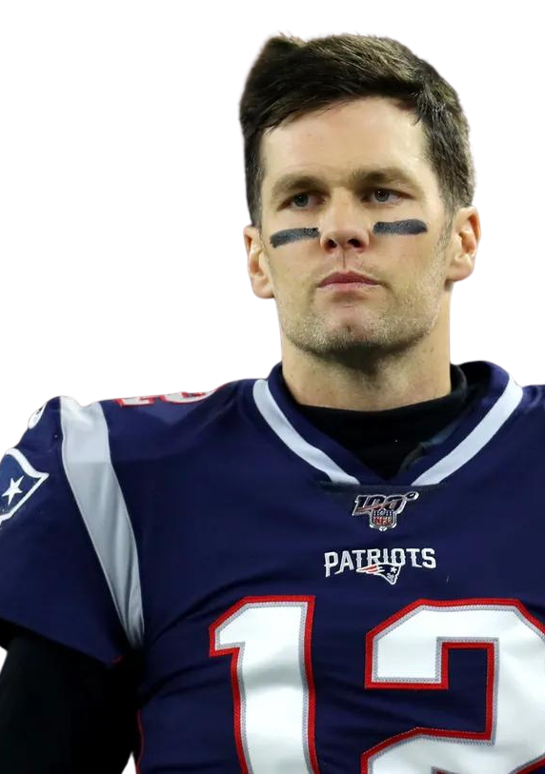
QUESTION WE WILL BE ANSWERING
What 3 key metrics a team needs to meet to be the winner of NFL game
01
Point Scored Diffrential
02
03
Turn Over Diffrential
Time Of Posstion
WINNER

Slide 6

DATA DISCUSSION
NFL GAME STATICS FROM ESPN FROM 2002 TO 2022 SEASON
FOCUS ON THE 3 STATICS
1
2
3
Point Scored
Turnovers
Time Of Possession

Slide 7

DATA EXPLORATION
CLEANING DATA
Cleaning Data
Only keeping needed colums
Creating our own table

Slide 8
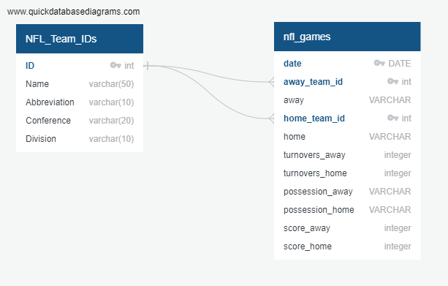
EDR DIAGRAM

Slide 9


PROJECT
ANALYSIS PHASE

Slide 10




MODEL DISCUSSION
The Ability to Predict The winner
Resources
Technology
Service
DATA
Machine Learning
Predict Game Winner

Slide 11
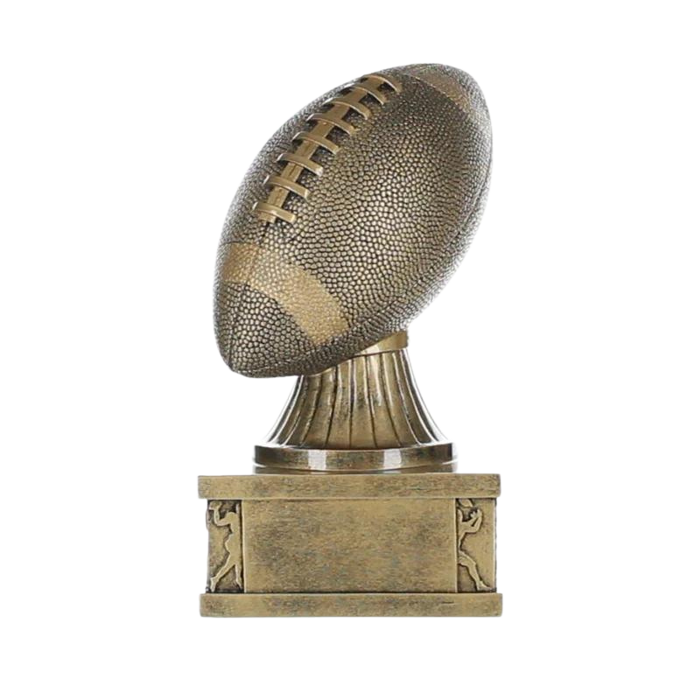
WAS THE MODEL SUCESSFUL?

Slide 12

OTHER MODEL ONE COULD USE ?

Slide 13

DATA VISUALAIZATION USED
250
209.2
200
150
100
50
27
6.1
14.1
0
2019
2020
2021
2022

Slide 14
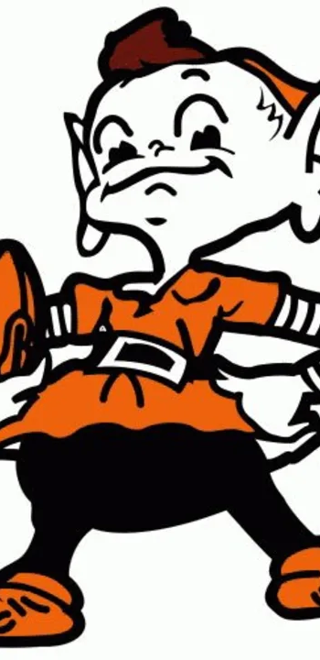

Do you have any questions?
We hope you learned something new.

